Slide 1
Lab 4
System Call
TA: Tzu-Han Chen
Professor：Hsung-Pin Chang
Operating System Lab

Slide 2
Outline
Introduction
Example – compile and install Linux Kernel from source code
Exercises
References

Slide 3
The definition of system calls (1/3)
System calls provide the interface between a process and an operation system.
Application program to request service from the operating system

Slide 4
The definition of system calls (2/3)
All modern systems offers a series of privilege levels.
The operating system executes at the highest level of privilege
Allows the applications to request services via system calls, which are often implemented through traps.

Slide 5
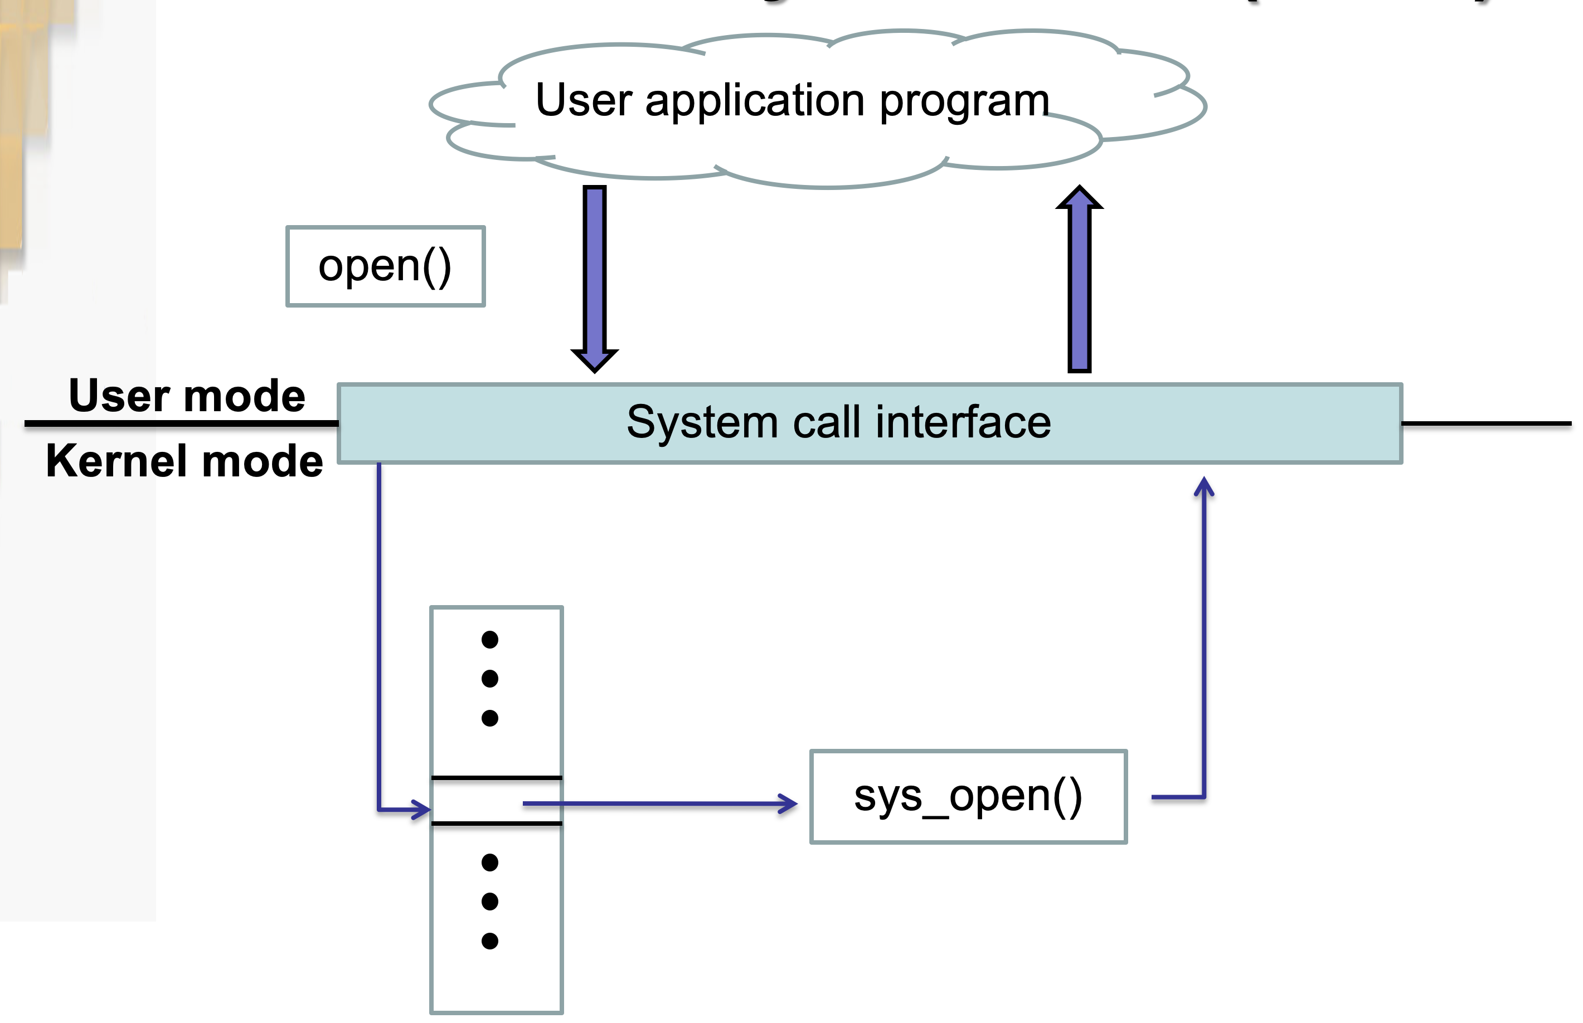
The definition of system calls (3/3)
i

Slide 6
Trap 流程
Process Execution
Signal from user program
Resume Execution
由Wrapper Routine產生Trap
User Mode
System call Interface
Enter the kernel mode
Leave the kernel mode
Mode bit : 1 ->0
Mode bit : 0 -> 1
Kernel Mode
System Call Handler (Trap handler)
Service Routine

Slide 7
Typical implementations of system calls
System calls can be roughly grouped into five major categories:
Process control
File management
Device management
Information maintenance
Communication

Slide 8
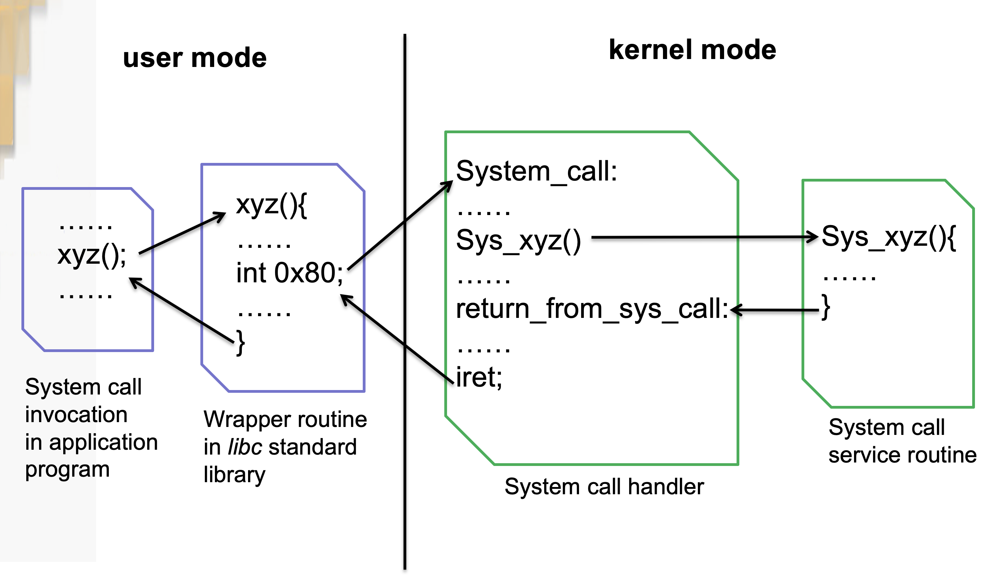
An example of system calls

Slide 9
Example –add a system call and compile Linux Kernel from source code

Slide 10
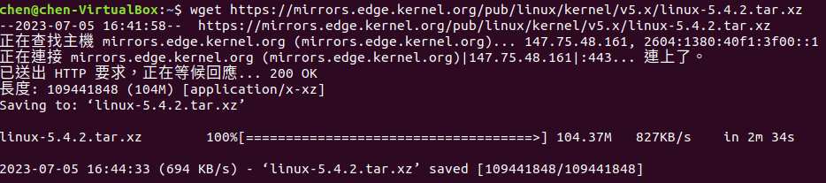
Step.1 Get the Linux kernel source code
Download linux kernal
Code: wget https://mirrors.edge.kernel.org/pub/linux/kernel/v5.x/linux-5.4.2.tar.xz

Slide 11
A Step-by-Step Tutorial
Install all needed packages for making the kernel
Add a new system call (Kernel will change if we add a new system call)
Make kernel and install our new kernel
Test the new system call

Slide 12
Extract tar.xz File
extract the source code
Code: tar -xvf linux-5.4.2.tar.xz
Linux-5.4.2 will be in your home directory.

Slide 13
Install the Compile Tools
sudo apt install build-essential
sudo apt install ccache
sudo apt install libssl-dev
sudo apt install bison
sudo apt install flex

Slide 14
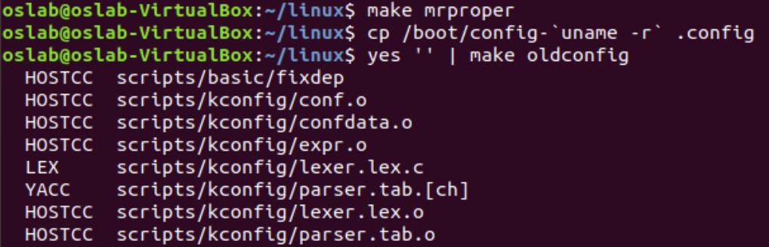
Transfer the Current Kernel Configuration
Clean all the previous configurations of the kernel source code
Code: cd linux-5.4.2
Code: make mrproper
we can transfer our current kernel configuration to the new kernel.
Code: cp /boot/config-`uname -r` .config
Code: yes '' | make oldconfig

Slide 15
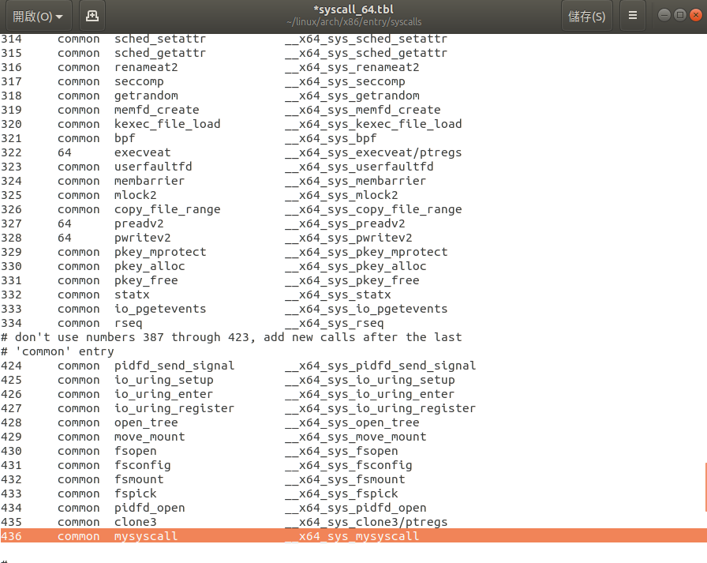
Add Customized System Call (1/3)
Add the System Call Number
arch/x86/entry/syscalls/syscall_64.tbl
Add the following code
Remember Line 436

Slide 16
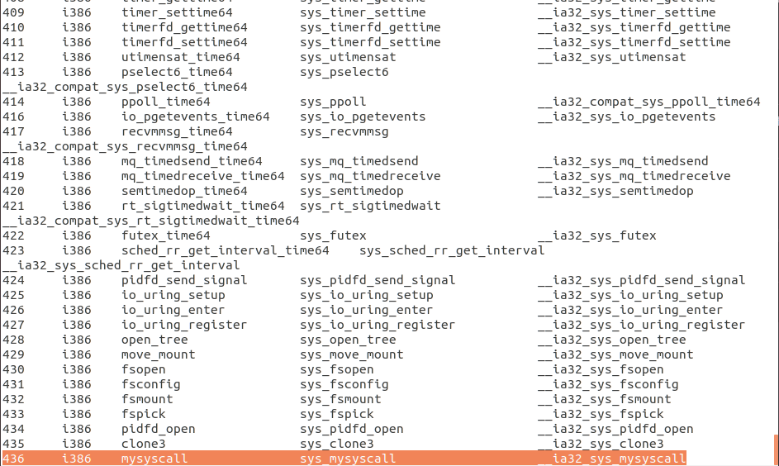
Add Customized System Call (2/3)
Also add it to the file syscall_32.tbl
arch/x86/entry/syscalls/syscall_32.tbl
Add the following code

Slide 17
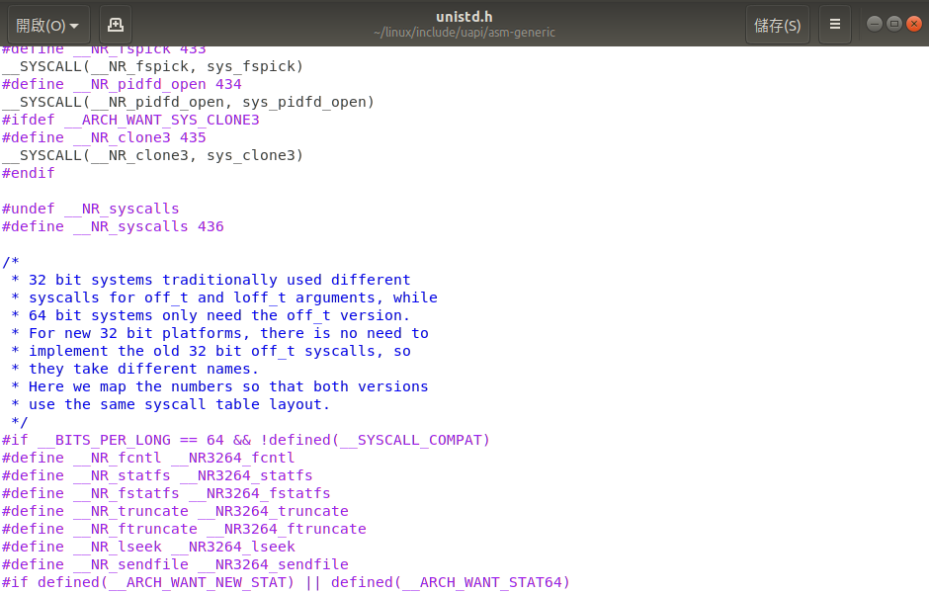
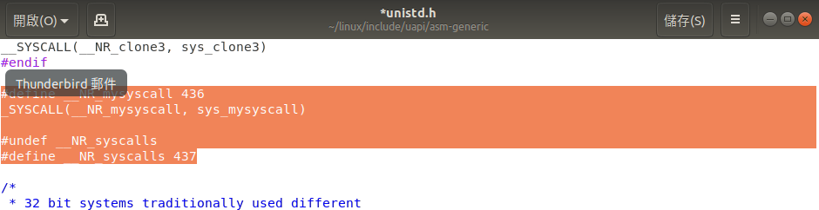
Add Customized System Call (3/3)
Add it to the unistd.h file as a micro
include/uapi/asm-generic/unistd.h
Add the following code

Slide 18
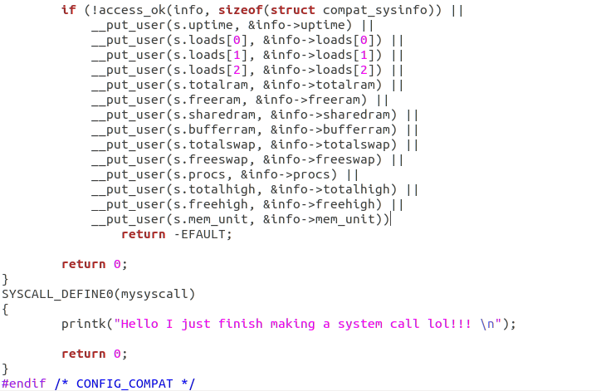
Implement the System Call Function (1/3)
kernel/sys.c
Append the following Syscall function to the end of the file.

Slide 19
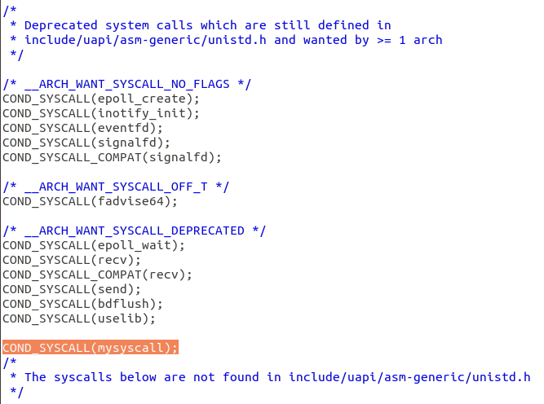
Implement the System Call Function (3/3)
For compatibility add the following code
kernel/sys_ni.c
Add the code
Code: COND_SYSCALL(mysyscall);

Slide 20
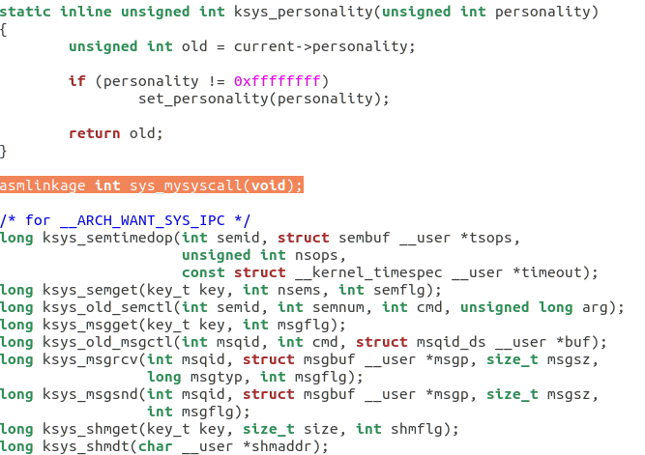
Implement the System Call Function (2/3)
Don’t forget the declaration
include/linux/syscalls.h
Add the line at almost the end of the file.
Code: asmlinkage int sys_mysyscall(void);

Slide 21
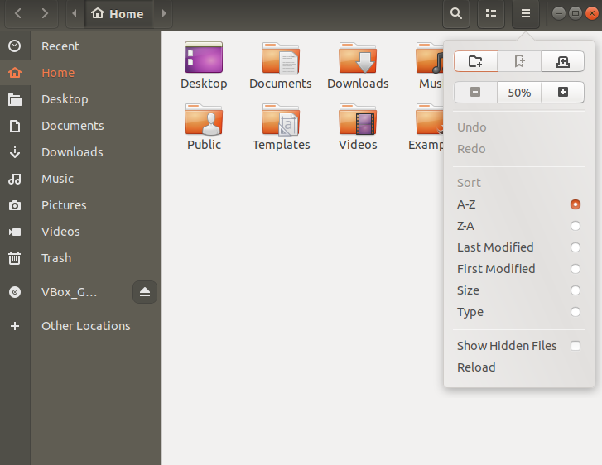
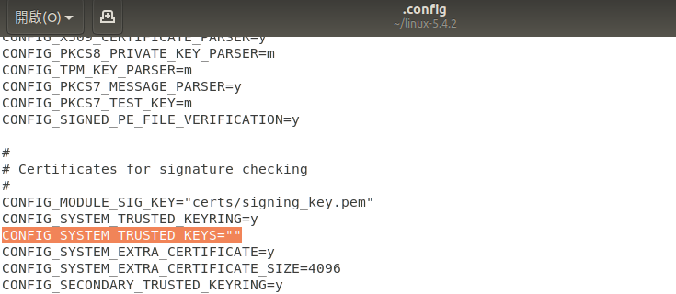

Slide 22
Congratulation! You have add a system call~

Slide 23
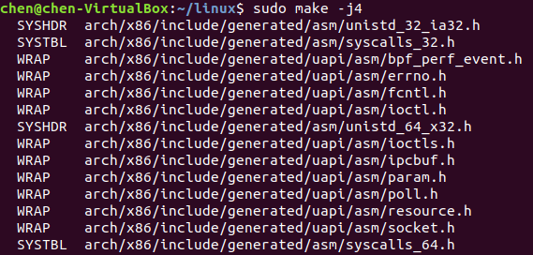
Compile the Kernel (2/2)
Code: sudo make -j4

Slide 24
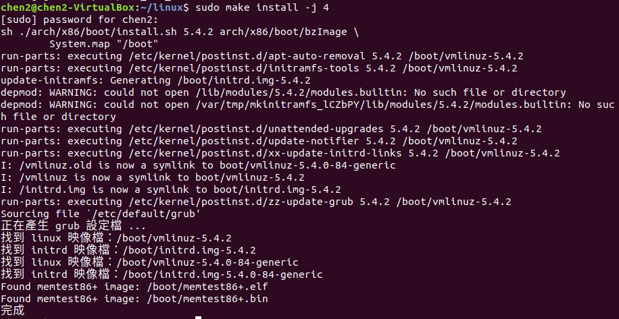
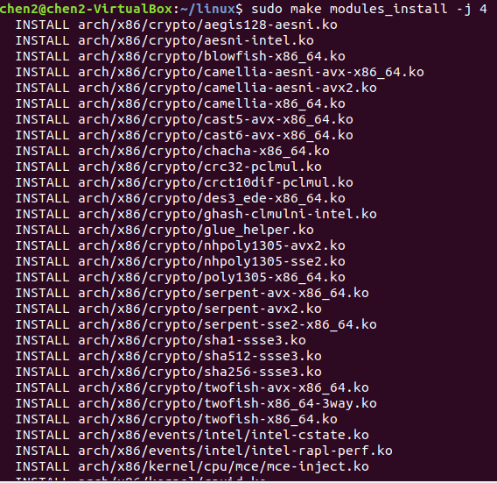
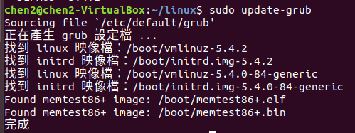
Install the Kernel
Code: sudo make modules_install -j 4
Code: sudo make install -j 4
Code: sudo update-grub

Slide 25

Verify
Reboot the system and check for kernel version
Code: sudo reboot
Check for kernel version code：uname -r

Slide 26
Congratulation! Linux Compile Kernel version 5.4.2
You completed various steps to build the Linux kernel from source code and compiled kernel should be running on your system

Slide 27
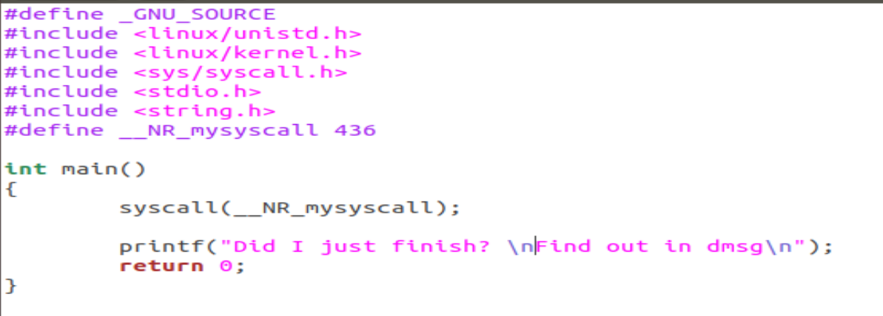
Test system call (1/2)
Create a test.c file code：gedit test.c
Type the following code
#define _GNU_SOURCE
#include <linux/unistd.h>
#include <linux/kernel.h>
#include <sys/syscall.h>
#include <stdio.h>
#include <string.h>
#define __NR_mysyscall 436
int main()
{
syscall(__NR_mysyscall);
printf("Did I just finish? \n Find out in dmsg\n");
return 0;
}

Slide 28
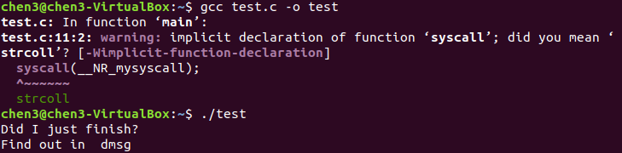
Test system call (2/2)
Compile test.c code：gcc test.c -o test
Run code：./test

Slide 29
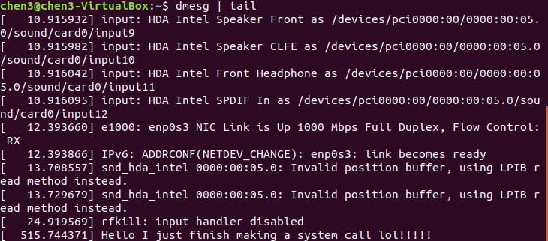
Kernel message
Use dmesg to check for kernel message code：dmesg | tail
Kernel successfully printk Hello I just finish making a system call lol!

Slide 30
Exercises
screenshot your kernel version [80 pt]
It has to be 5.4.2
using the newly created system call [20pt]

Slide 31
Successfully finished using the New system call

Slide 32
References
operating-system-concepts-10th
System call
Add a system call in linux

Slide 33
The End

